Slide 1

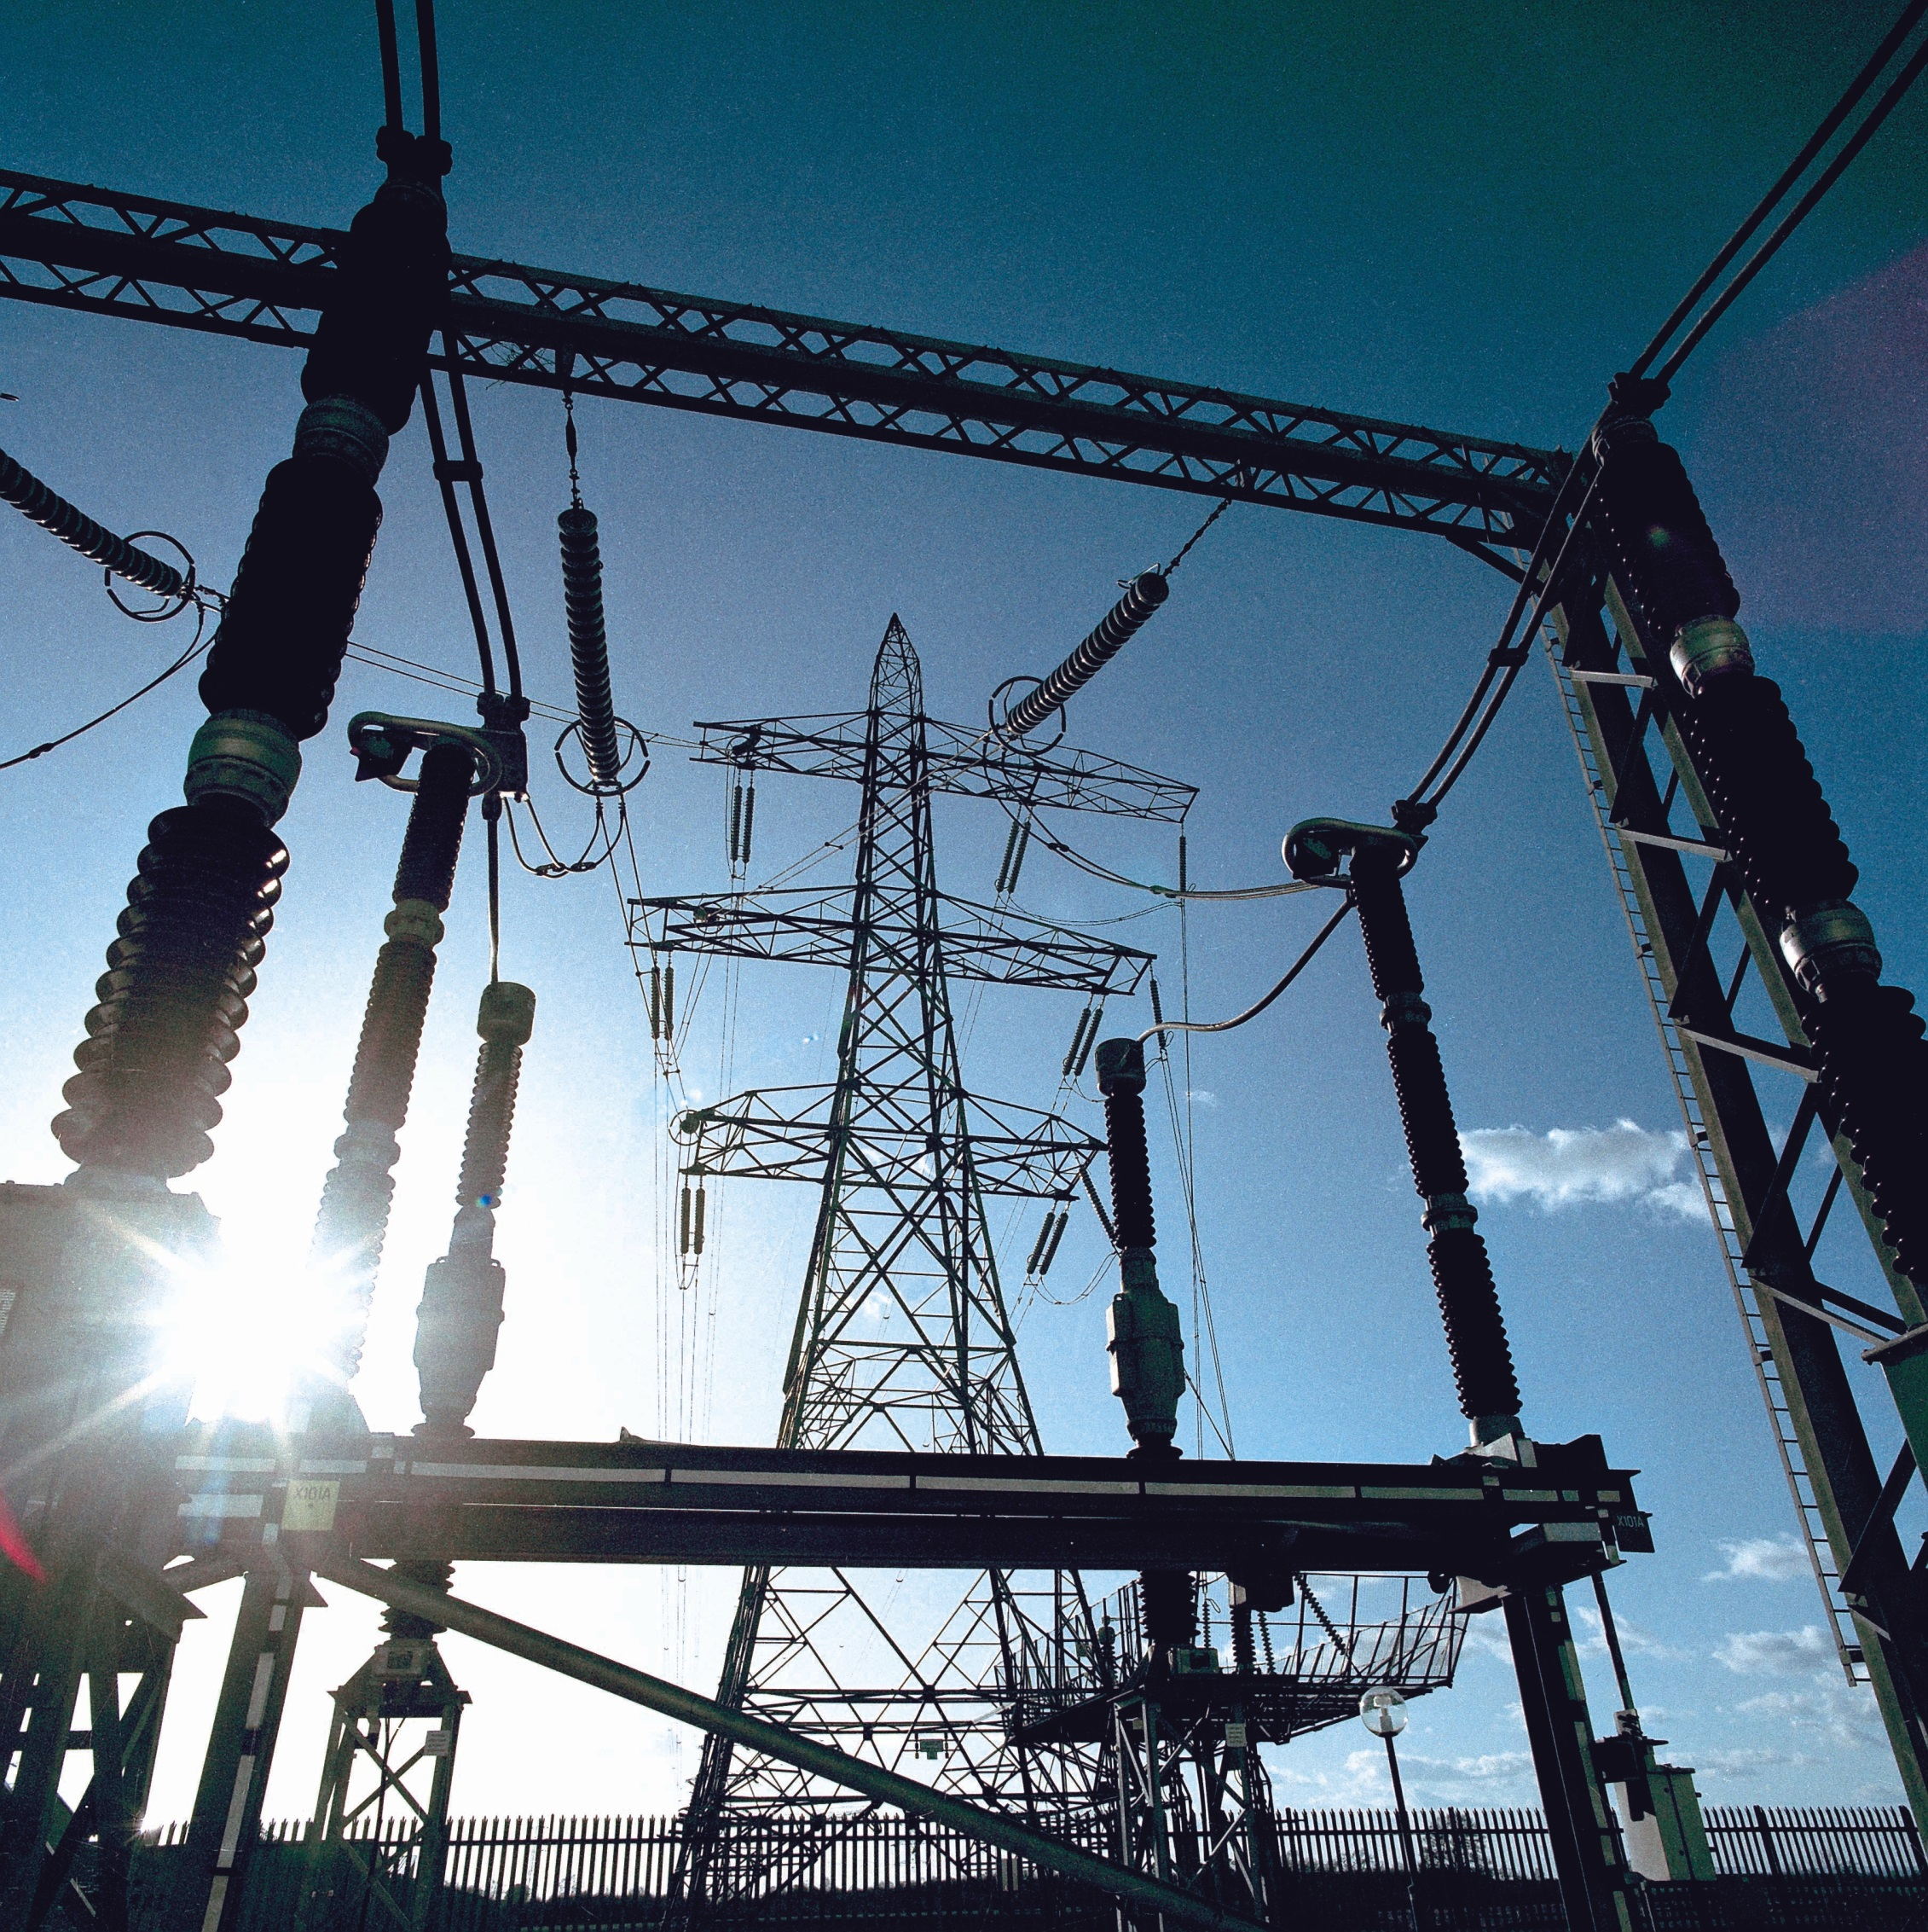
An energy technology powerhouse
Largest
independent technical advisor on renewable energy and 2,500 energy experts
>25
standards and guidelines published as a leading certification body
No 1
in high power and high voltage testing with 10 laboratories incl. our leading lab in Arnhem
90
years experience in
the power industry, including 30 years in energy efficiency and wind energy

Slide 2

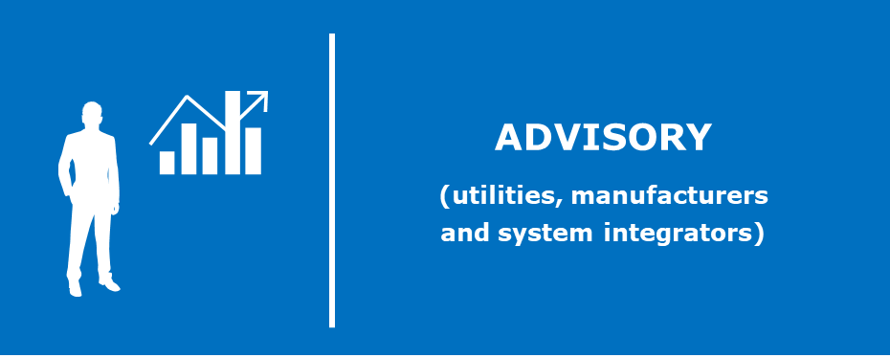

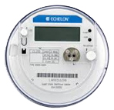



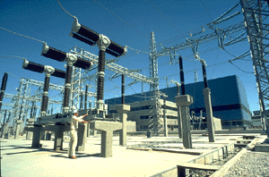

Our Focus area: smart grid protocols
DLMS, PRIME, SML
M-Bus, IDIS, OSGP
Grid operator
(DSO, TSO)
Smart meter
IEC 60870-6
IEC 61970
IEC 61968 (CIM)
Grid operator
IEC 60870-5-101
IEC 60870-5-104
IEC 61850
IEC 62351
DNP
CIM
Renewables/DER
IEC 61400-25
(Digital)
Substation
IEC 61850/IEC 62351
IEC 60870-5-103
DNP
(Digital)
Substation
SDH/PDH MPLS PLC Public Cellular RF Mesh
(GPRS, CDMA, LTE)
Telecom
Infra-structure
Notes:
104 will be replaces by 61850 in ten years

Slide 3




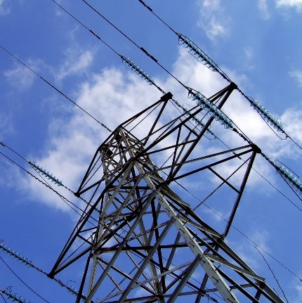
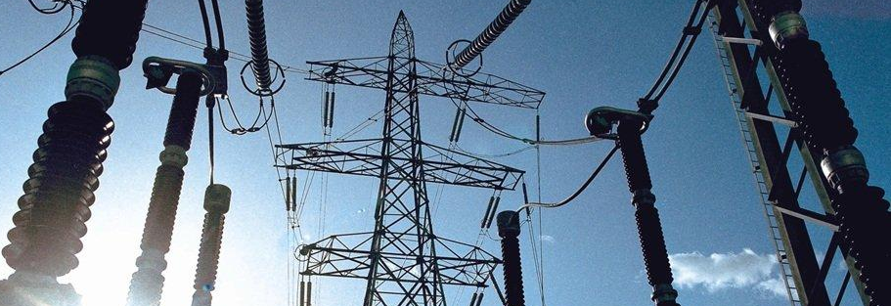
Our services: Advisory, Training, Testing and Test tools
Evaluation of standards and technologies for upgrading
existing systems
Design and optimization
of the telecommunication architecture
for open standards
Testing: IEC 61850
IEC 61400
IEC 60870-5-101/104 – DNP3
TASE.2
DLMS / M-BUS
Test Tools
Simulator and Analyzers for:
IEC 61850 (Unigrid SA, Unica) IEC 60870-5-104 incl. IEC 62351-3/-5 (Unigrid Telecontrol), Tase.2, DLMS , M-Bus
Development of data communications models and (vendor-independent) requirements (PID)
Expert
knowledge
on site, commissioning, independent witness testing
Development of
data communications
profiles and
(vendor-independent) requirements

