Slide 1
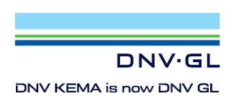
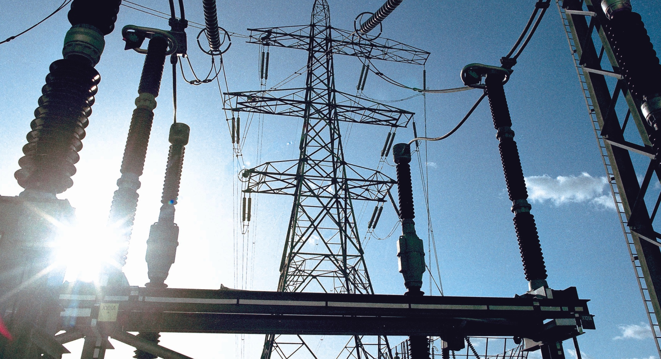
An energy technology powerhouse
Largest
independent technical advisor on renewable energy and 2,500 energy experts
>25
standards and guidelines published as a leading certification body
No 1
in high power and high voltage testing with 10 laboratories incl. our leading lab in Arnhem
90
years experience in
the power industry, including 30 years in energy efficiency and wind energy

Slide 2

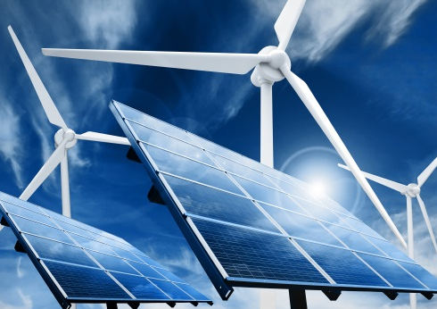
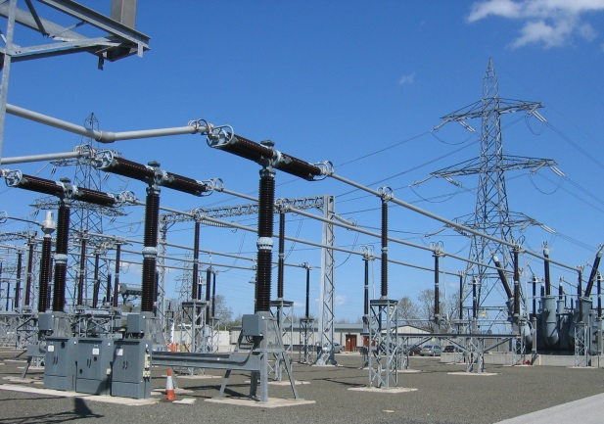
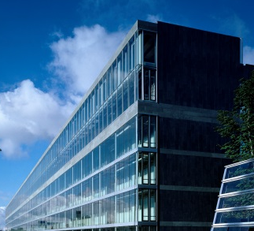
Global service portfolio
Policy
Production
Transmission & distribution
Use
Software, testing & training services based upon
  IEC 61850 edition 1 and 2
  IEC 61400-25 (wind power)
  IEC 61970 / 61968 (CIM)
  IEC 60870-5 / DNP3
  IEC 60870-6 (Tase.2/ICCP)
Software, testing & training services of the next Smart Meter standards:
  DLMS/COSEM & SML & IDIS
  PLC (PRIME & G3)
  M-BUS
Policy
Production
Transmission
& Distribution
Use
Also contact us for requirement specifications, procurement support, workshops and roll-out management for both utilities and technology providers
Notes:
DNV GL brings together knowledge that covers the value chain: from policy and regulation to generation (conventional and renewable), through transmission and distribution, and the efficient use of energy.
Our global service portfolio consists of:
Independent, accredited certification of electricity transmission & distribution components
Product and project certification for the renewables industry.
Advisory services spanning the entire energy value chain, with a strong focus on energy efficiency, renewable integration, clean conventional power generation, T&D grids, energy storage, measurements and cyber security.
This breadth of knowledge enables us to support you in understanding the technical consequences of business decisions and the business consequences of technical decisions.

