Slide 1

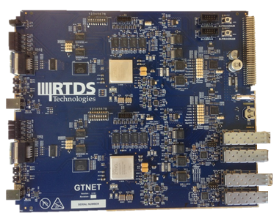
enhancing our hardware performance www.rtds.com
The powerful new GTNETx2 card
Double the capability: operate 2 protocols simultaneously
Runs 5-10 times faster than previous card
Same price as previous card
Exchange program available for existing GTNET users
Visit us at booth 271 behind ABB

Slide 2
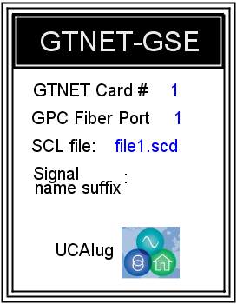
performance through innovation www.rtds.com
Enhancing our IEC 61850 capabilities
MMS Voyageur client software: Free upgrade for existing users; operated directly via RSCAD RunTime
GTNET-GSE v5: Supports 4 TX/RX modules, each capable of publishing up to 64 points for up to 16 unique IEDs
GTNET-SV non-9.2LE mode: Developed for IEC 61869-9 and the Chinese National Standard; streams up to 24 voltage/current signals
Visit us at booth 271 behind ABB

