Slide 1





Enabling Interoperability for the Utility Enterprise
And TESTING

Slide 2
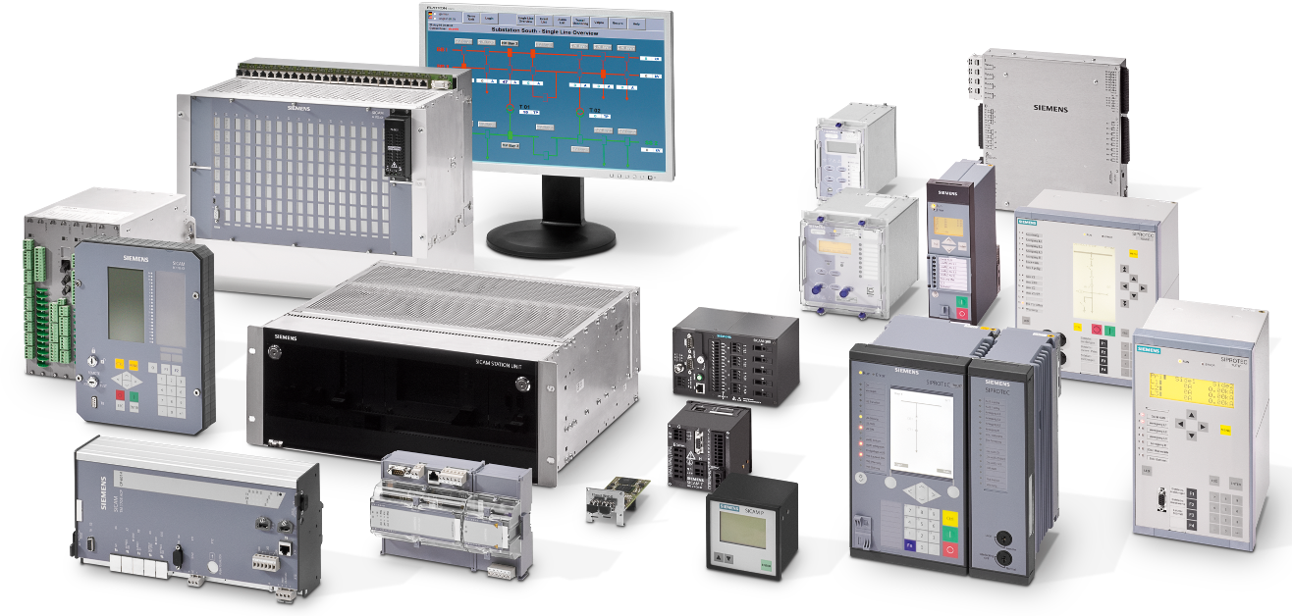
Energy Automation from Siemens – SIPROTEC and SICAM
Benchmark for Quality, Reliability and Integration
© Siemens AG 2014 All rights reserved.
Notes:
2

Slide 3
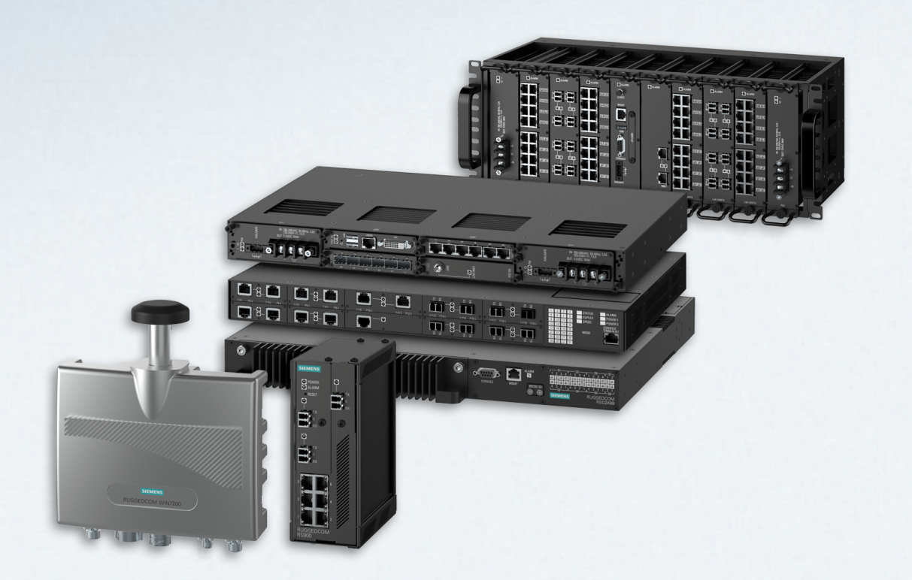



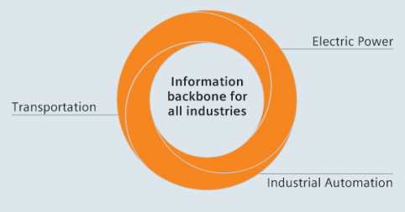
Siemens RUGGEDCOM
Rugged Communications Networks for Mission Critical Applications in Harsh Environments
RUGGEDCOM products provide a level of robustness and reliability that have set the standard for communications networks deployed in harsh environments.

