Slide 1
AMA-61850-FiT4HANA
Designed for Big Data
A Cooperation Between AMA-SYSTEMS, Fichtner IT and SAP
Visit Us at Booth #359

Slide 2
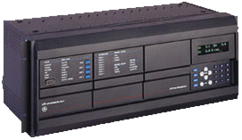
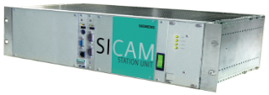
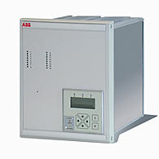
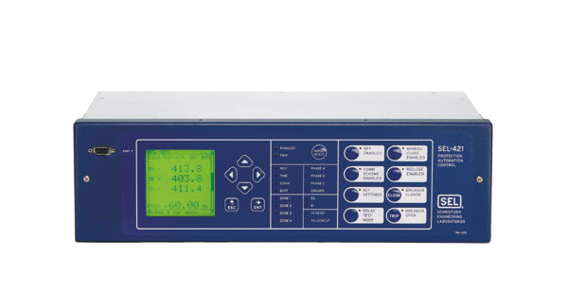
IEC 61850 Interface
SAP
HANA
Provides direct access to data of IEC 61850 Server devices (IEDs) without the need for an additional Gateway protocol like OPC, ODBC.
Direct access to IEC 61850 avoids the disadvantages of such Gateway Protocols as additional mapping effort, risk of Mapping Errors, Communication Bottle-Neck, ...
AMA-SYSTEMS
IEC 61850 Client Interface
Reports
Data Change, Periodic
Read Request
Read Response
Ethernet, TCP/IP
Other
IEC 61850 Devices

