Slide 1
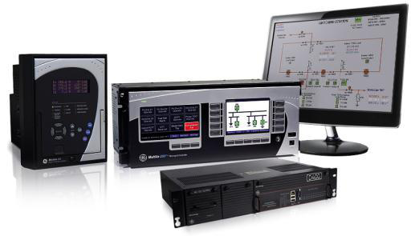

Industry Leading Protection, Control and Automation Products & Systems
Enable the world’s utility and industrial power grids to operate efficiently, reliably and securely.
With over 100 years of experience in delivering innovative solutions for protecting, and managing power system assets, GE’s products and systems greatly increases the reliability, efficiency and security of the electrical infrastructure.
With over one million Multilin
products installed worldwide,
we bring industry-leading
experience to solve customer
problems

Slide 2
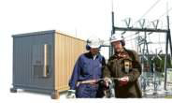
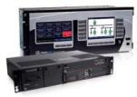
Grid Automation
Product Portfolio
Protection & Control Relays
Enhanced system reliability & security with high speed devices and tools
Automation Gateways
Seamless & scalable solution with Gateways, RTUs & Ethernet Switches
Asset Monitoring and Diagnostics
Proactive asset maintenance with Relays with build-in monitoring & diagnostic intelligence.
Industrial Digital Meters
Monitor & optimize energy usages wit power monitors to advanced power quality meters
Fault Sensors
Real-time information on line outages & available
capacity with advanced fault indicators
Solution Portfolio
Substation Projects
Complete turnkey EPC transmission & distribution solutions
Automation Projects
Integrated packaged solution with protection & automation for all kinds of electrical substations
Industrial Energy Management
Customers more efficiently energy use with fully integrated energy management system
Power Energy Consulting Services
Experienced engineer teams for wide range of protection & automation consulting services
Advanced Training Services
In-class , on-site & interactive treaning CDs in power system protection, automation and control.
Maximizing Grid Reliability, Efficiency, Security & Operational Excellence

