Slide 1





Enabling Interoperability for the Utility Enterprise
And TESTING

Slide 2

SimFlex™ IEC61850 Simulators & Test Tools
IEC61850 Custom Development
IEC61850 Product Implementation Support
UCA© iug Level A/B Accreditation Support
www.gridclone.com

Slide 3

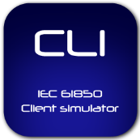
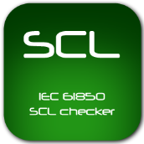
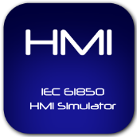
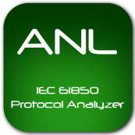

Product Portfolio - SimFlex™
The SimFlex™ Client Simulator is also an UCA© IEC 61850 Conformance Test compliant.
The SimFlex™ SCL Checker also provides in-depth verification of
SCL files in a matter of seconds.
The SimFlex™ HMI Simulator is an SCL based tool to simulate SCADA and HMI functions. Most convenient during FAT/SAT.
The SimFlex™ Protocol Analyzer provides human readable network communication information for the IEC 61850 engineer.
The SimFlex™ Server Simulator is a advanced tool for simulating IEDs by loading an IEC 61850 SCL file.
info@gridclone.com

