Slide 1





Enabling Interoperability for the Utility Enterprise
And TESTING

Slide 2
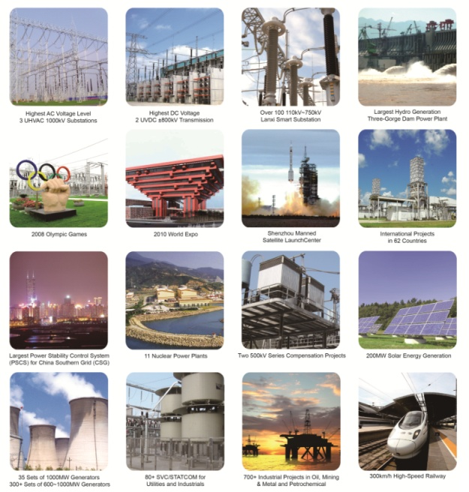

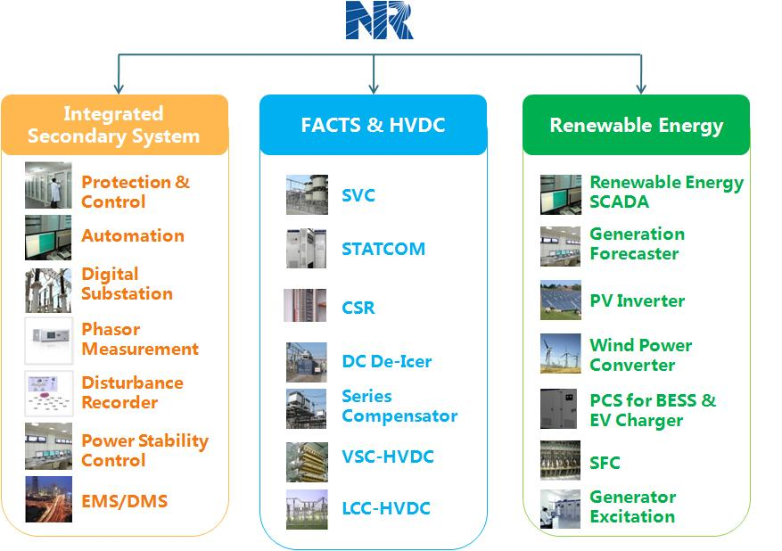






















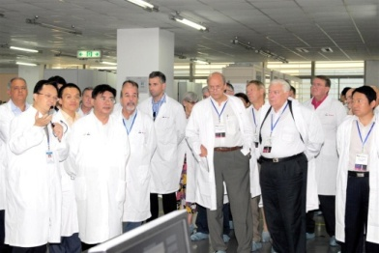
Product Portfolio
Power System Stability Expert
  Projects in 71 countries outside China
  650,000+ IEDs in service worldwide
  10,000+ substations from 110kV to 1000kV
  The first Five-Terminal-VSC-HVDC transmission in the world
  Complete solution of 900MW Static Car Compensator (SVC)
Welcome to visit NR at booth #244

Slide 3
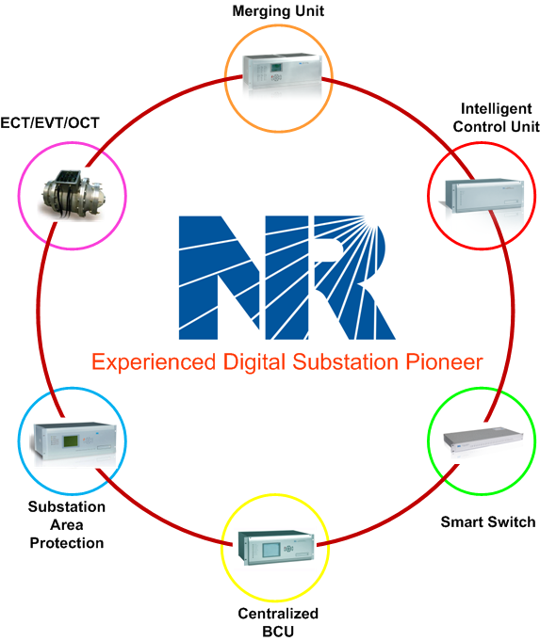
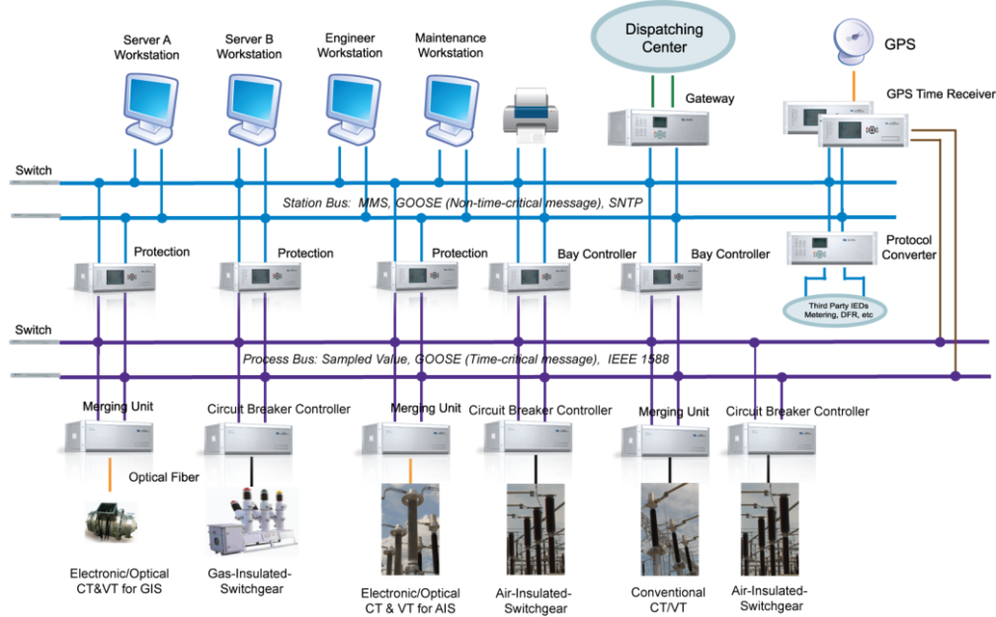
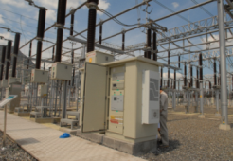
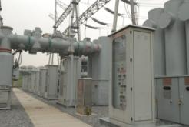
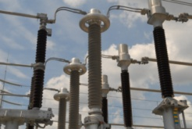
Digital Substation-Comprehensive solution with IEC61850
Field Photos
  1000+ Digital Substations with Full Fiber Connections
  3500+ Merging Units (MUs) in Service
  4000+ Intelligent Control Units (ICUs) in Service
  600+ Electronic CT/VTs and Optical CTs in Service
  Highest Voltage Level of Digital Substation: 750kV
Merging Unit
  Low Cost
  100% Fiber
  Process Bus
  Less Maintenance
  Data Sharing
  Immunity to electro-magnetic induction
Intelligent Controller
Optical CT/VT
Experienced Digital Substation Pioneer
Welcome to visit NR at booth #244

