Slide 1
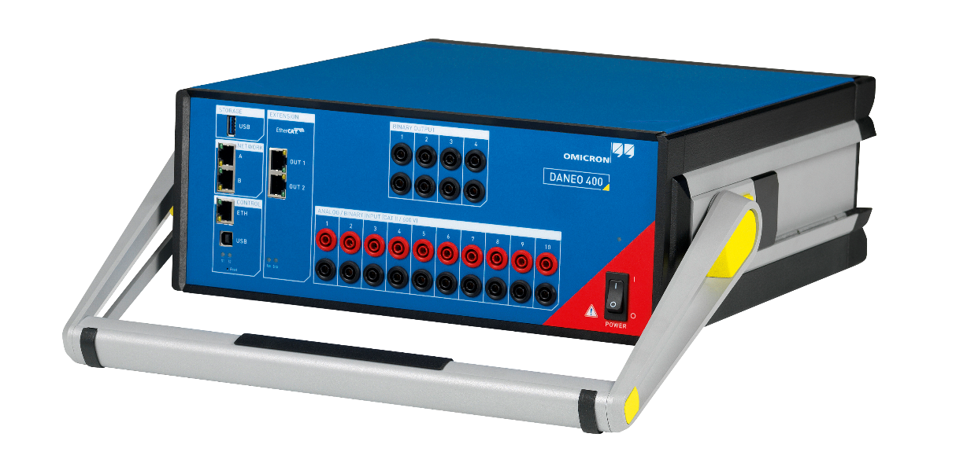
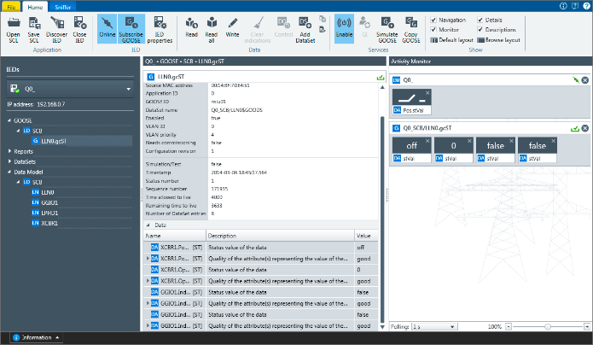

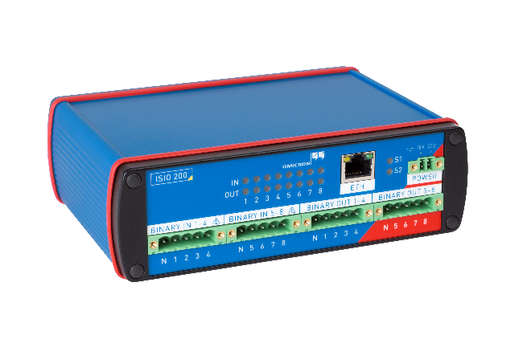
IEC 61850 Tools
    Recording of IEC 61850 traffic and
    power system quantities (V, I, …)
    HSR timing measurements
    Distributed measurements with
    multiple acquisition units
    Powerful SW tools for analyzing
    IED communication
    In-depth SCL file analysis
    Binary I/O terminal with GOOSE interface

Slide 2
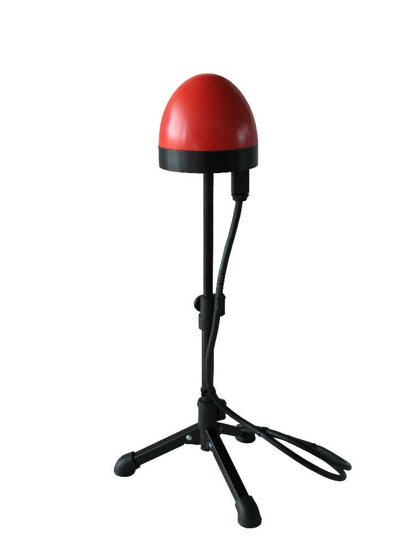
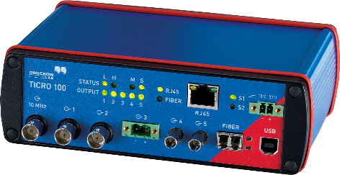
Precision Timing Solutions
    IEEE 1588 grandmaster clock
    IEEE C37.238 Power Profile
    NTP time server
    GPS receiver and clock combined in one weatherproof housing
    Powered over Ethernet
    PTP conversion to legacy time codes
    Provides IRIG-B and PPS on multiple outputs
    Highly stable internal oscillator

