Slide 1


Toshiba Protection and Substation Automation
“Creating T&D solutions with IEC 61850”
With over 100 years experience Toshiba Corporation is leading innovation in the creation of total solutions for protection, control and automation of power networks at all transmission and distribution voltage levels. Our protection and substation automation products support the IEC 61850 standard for communication and interoperability
http://www.toshiba-relays.com

Slide 2



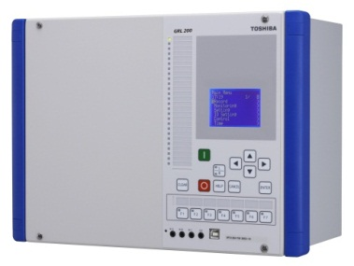
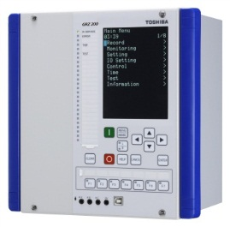
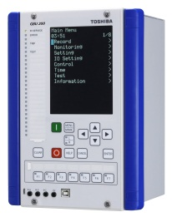
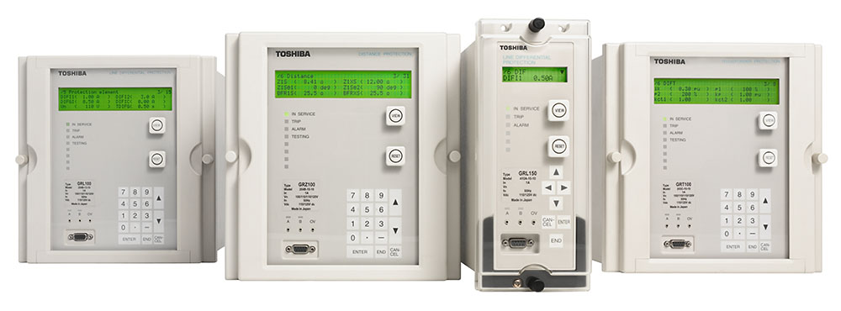
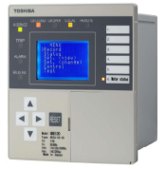
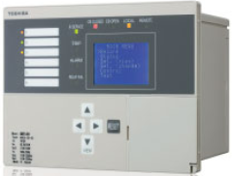

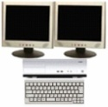


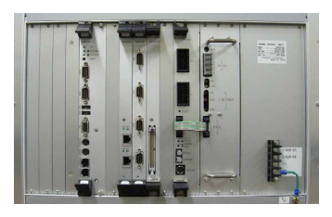
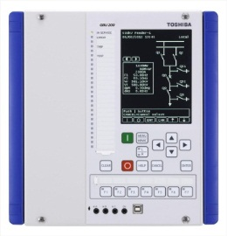
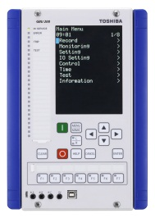



New Generation Protection & Control IED
GR-100 Series
Protection IED for T&D Systems
GRE Series
Compact IED for MV Systems
Remote Control Centre
HMI
IEC 60870-5-101/104
GSC1000
GPS
Station Computer
Substation Automation System
IEC 61850 Station Bus
BCU
http://www.toshiba-relays.com
Relay

