Slide 1

TÜV SÜD is the world’s largest independent technical service provider
1
One-stop technical solution provider
150
years of experience
800
locations worldwide
1,900
million Euro in sales revenue 2013
20,200
employees worldwide

Slide 2
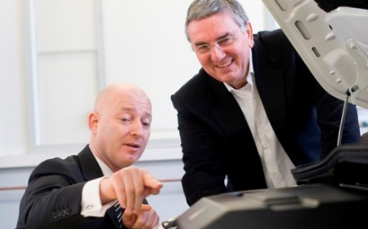
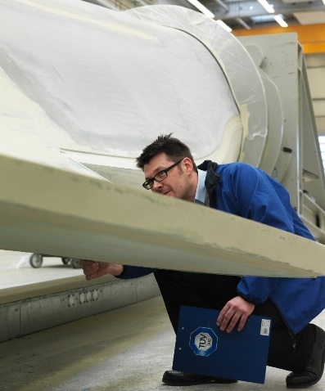
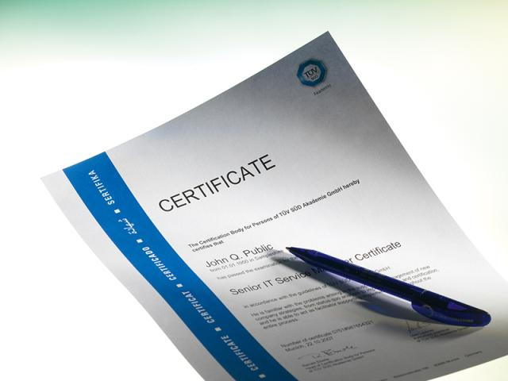



Testing, consulting, certification and training solutions for business success
IEC 61850 Ed.1 & 2 UCAIug Level A Certification
IEC 61400-25 Testing
IEC 62439-3 PRP/HSR Redundandcy Testing
IEC/ISO 15118 V2G e-Mobility
IEC 62443/62351 Industrial IT Security
Training and Advisory Services
Technical Due Diligence
Regulatory compliance assessment
Consulting
Testing
Certification
Training

